Slide 1
Fundamental Data types
4.1-4.2

Slide 2
Number Types
Every value in Java is either:
a reference to an object
one of the eight primitive types
Java has eight primitive types:
four integer types
two floating-point types two other

Slide 3
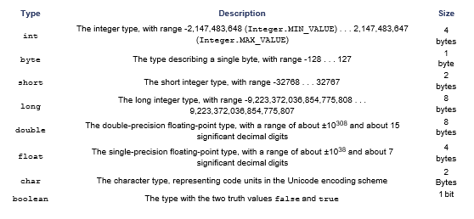
Primitive Types

Slide 4
Number Literals
A number that appears in your code If it has a decimal, it is floating point If not, it is an integer

Slide 5
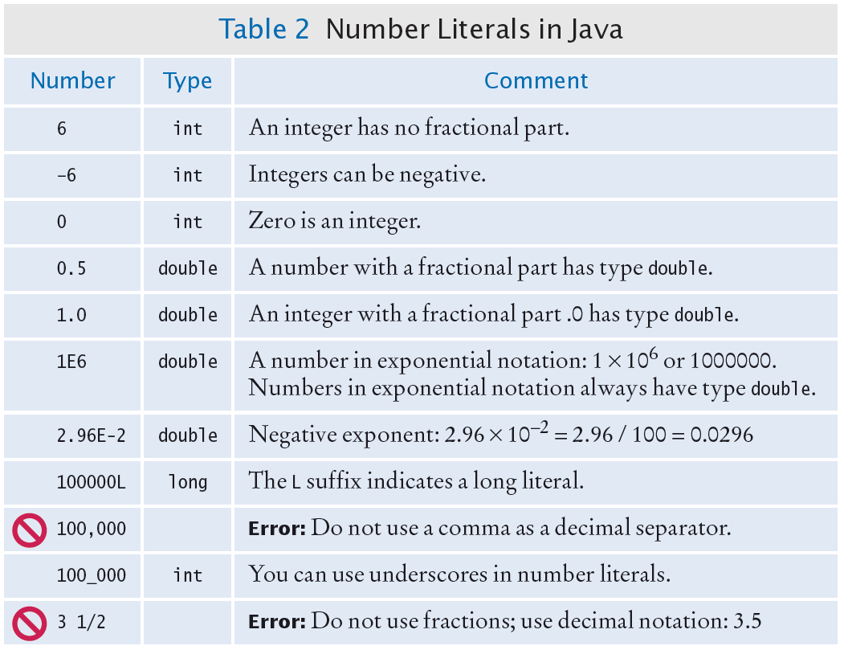

Slide 6

Overflow
Generally use an int for integers Overflow occurs when
The result of a computation exceeds the range for the number type
Example
int n = 1000000;
System.out.println(n * n); // Prints –727379968,
// which is clearly wrong
10¹² is larger that the largest int The result is truncated to fit in an int No warning is given
Solution: use long instead
Generally do not have overflow with the double data type

Slide 7

Rounding Errors
Rounding errors occur when an exact representation of a floating-point number is not possible.
Floating-point numbers have limited precision. Not every value can be represented precisely, and roundoff errors can occur.
Example
double f = 4.35;
System.out.println(100 * f); // Prints 434.99999999999994
Use double type in most cases

Slide 8
Constants: final
Use symbolic names for all values, even those that appear obvious. A final variable is a constant
Once its value has been set, it cannot be changed
Named constants make programs easier to read and maintain. Convention: use all-uppercase names for constants:
final double QUARTER_VALUE = 0.25; final double DIME_VALUE = 0.1; final double NICKEL_VALUE = 0.05; final double PENNY_VALUE = 0.01;
payment = dollars + quarters * QUARTER_VALUE + dimes * DIME_VALUE
+ nickels * NICKEL_VALUE + pennies * PENNY_VALUE;

Slide 9
Constants: static final
If constant values are needed in several methods,
Declare them together with the instance variables of a class Tag them as static and final
The static reserved word means that the constant belongs to the class
Give static final constants public access to enable other classes to use them: Declaration of constants in the Math class
public class Math
{
. . .
public static final double E = 2.7182818284590452354; public static final double PI = 3.14159265358979323846;
}
Using a constant
double circumference = Math.PI * diameter;

Slide 10
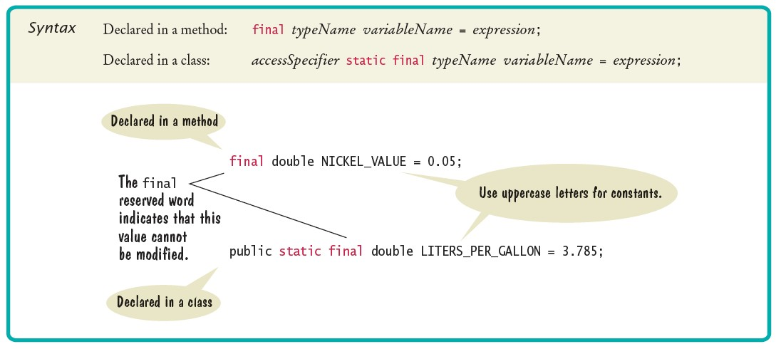
Syntax 4.1 Constant Declaration

Slide 11
Arithmetic Operators
Four basic operators:
addition: + subtraction: - multiplication: * division:/
Expression: combination of variables, literals, operators, and/or method calls
Parentheses control the order of the computation
Multiplication and division have a higher precedence than addition and subtraction
Mixing integers and floating-point values in an arithmetic expression yields a floating- point value
7 + 4.0 is the floating-point value 11.0

Slide 12
Integer Division and Remainder
Division works as you would expect, as long as at least one of the numbers is a floating-point number.
Example: all of the following evaluate to 1.75
7.0 / 4.0
7 / 4.0
7.0 / 4
If both numbers are integers, the result is an integer. The remainder is discarded
7 / 4 evaluates to 1
Use % operator to get the remainder with (pronounced "modulus", "modulo", or "mod")
7 % 4 is 3

Slide 13

Integer Division and Remainder
To determine the value in dollars and cents of 1729 pennies
Obtain the dollars through an integer division by 100
int dollars = pennies / 100; // Sets dollars to 17
To obtain the remainder, use the % operator
int cents = pennies % 100; // Sets cents to 29
Integer division and the % operator yield the dollar and cent values of a piggybank full of pennies.

Slide 14
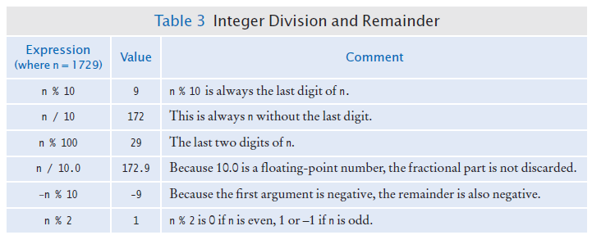
Integer Division and Remainder

Slide 15

Powers and Roots
Math class contains methods sqrt and pow to compute square roots and powers To take the square root of a number, use Math.sqrt; for example, Math.sqrt(x)
To compute x^{n}, you write Math.pow(x, n)
To compute x² it is significantly more efficient simply to compute x * x
In Java,
can be represented as
b * Math.pow(1 + r / 100, n)

Slide 16
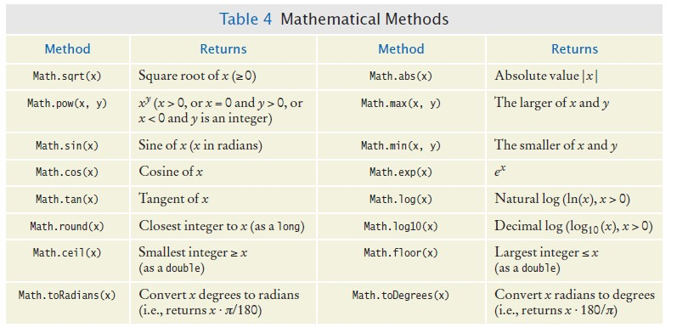
Mathematical Methods

Slide 17
Converting Floating-Point Numbers to Integers - Cast
The compiler disallows the assignment of a double to an int because it is potentially dangerous
The fractional part is lost
The magnitude may be too large This is an error
double balance = total + tax;
int dollars = balance; // Error: Cannot assign double to int
Use the cast operator (int) to convert a convert floating-point value to an integer.
double balance = total + tax; int dollars = (int) balance;
Cast discards fractional part (truncation)
You use a cast (typeName) to convert a value to a different type.

Slide 18
Converting Floating-Point Numbers to Integers - Rounding
Math.round converts a floating-point number to nearest integer:
long rounded = Math.round(balance);
If balance is 13.75, then rounded is set to 14.

Slide 19
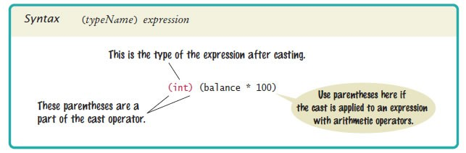
Syntax 4.2 Cast

Slide 20
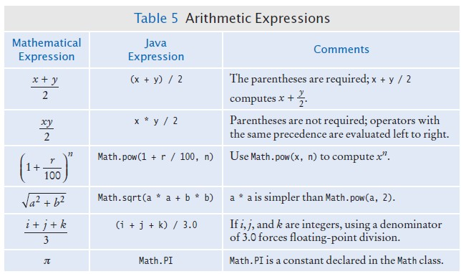
Arithmetic Expressions

Slide 21
Self Check 4.7
In Java, how do you compute the side length of a square whose area is stored in the variable area?
Answer: double sideLength = Math.sqrt(area);

Slide 22

Self Check 4.8
The volume of a sphere is given by
If the radius is given by a variable radius of type double, write a Java expression for the volume.
Answer:
4 * PI * Math.pow(radius, 3) / 3
or (4.0 / 3) * PI * Math.pow(radius, 3),
but not (4 / 3) * PI * Math.pow(radius, 3)

Slide 23
Self Check 4.9
What are the values of 1729 / 100 and 1729 % 100?
Answer: 17 and 29

Slide 24
Self Check 4.10
If n is a positive number, what is (n / 10) % 10?
Answer: It is the second-to-last digit of n. For example, if n is 1729, then n / 10 is 172, and (n / 10) % 10 is 2.

